Slide 1
Các vấn đề khác trong SE
BM CNPM – Khoa CNTT – HVKTQS
10/2012

Slide 2
Outline
Quản lý dự án phần mềm:
  Kiểu thành viên
  Quản lý nhóm phát triển phần mềm
Ước lượng chi phí phần mềm (SE Cost Estimation)
Cải tiến qui trình phát triển phần mềm (Software Process Improvement)

Slide 3
Software project management
Liên quan đến các hoạt động đảm bảo:
    Phần mềm cần được giao đúng thời gian và đúng tiến độ;
    Phù hợp với các yêu cầu của các tổ chức phát triển và khách hàng.
Quản lý dự án là cần thiết vì
  Việc phát triển phần mềm luôn bị hạn chế ngân sách và lịch trình được thiết lập bởi tổ chức phát triển phần mềm.

Slide 4
Software management – nét riêng
Sản phẩm vô hình.
Phần mềm là loại sản phẩm linh hoạt duy nhất.
Quy trình phát triển phần mềm không được chuẩn hóa.
Nhiều dự án phần mềm chỉ được thực hiện một lần.

Slide 5
Management activities
Proposal writing (viết đề xuất).
Project planning and scheduling (Lập kế hoạch và lập lịch dự án).
Project costing (Lập chi phí dự án).
Project monitoring and reviews (Giám sát và ra soát dự án).
Personnel selection and evaluation (Lựa chọn nhân sự và đánh giá).
Report writing and presentations (Ghi chép và báo cáo thống kê).

Slide 6
Project staffing – Nhân sự
Thường không có những con người lý tưởng trong các dự án
  Ngân sách dự án không cho phép sử dụng các nhân viên được trả lương cao;
  Có thể không có những nhân viên có kinh nghiệm thích hợp;
  Tổ chức muốn phát triển kỹ năng nhân viên thông qua dự án.
Các nhà quản lý phải làm việc với những khó khăn đặc biệt khi có sự thiếu hụt của đội ngũ nhân viên được đào tạo.

Slide 7
Chú ý: Nhóm sản xuất phần mềm
Yêu cầu với những thành phần này:
  Tri thức phần cứng
  Khả năng tiếp cận hệ thống
  Kiến thức cơ bản về toán và thuật toán
  Những hiểu biết về công nghệ phần mềm
  Biết một số ngôn ngữ lập trình
  Khả năng tiếp thị
  Ngoài ra, mỗi người phải giỏi về lĩnh vực mình phụ trách. Cụ thể:
  + Chủ nhiệm đề tài phải là người có khả năng nhất về mặt tổ chức, quán xuyến các công việc chung, có khả năng đối nội đối ngoại và khả năng tâm lí học.
  + Người phân tích thiết kế hệ thống là người giỏi nhất về chuyên môn, phụ trách thu nhận yêu cầu của khách hàng để thiết kế 1 hệ thống đáp ứng của khách hàng.
  + Tiếp đến là người phụ trách phần mềm, có nhiệm vụ trợ giúp cho cả nhóm, cung cấp cho nhóm tất cả các chương trình trợ giúp liên quan, các phần mềm liên quan, các công cụ. Điều đó giúp giảm bớt thời gian, công sức và sự trùng lặp.
Chủ nhiệm
Cán bộ phân tích thiết kế hệ thống
Cán bộ phụ trách phần cứng
Cán bộ phụ trách phần mềm
Các lập trình viên
Những người phụ trách marketing

Slide 8
People in the process
People are an organisation’s most important assets.
The tasks of a manager are essentially people-oriented. Unless there is some understanding of people, management will be unsuccessful.
Poor people management is an important contributor to project failure.

Slide 9
People management factors
Consistency (Tính nhất quán): tất cả các thành viên của đội phát triển cần được đối xử một cách công bằng, không phân biệt đối xử
Respect (Tôn trọng): các thành viên trong nhóm có các kỹ năng khác nhau và những khác biệt đó cần được tôn trọng
Inclusion (Hòa đồng): Có sự tham gia của tất cả các thành viên trong nhóm vào mọi công việc, chắc chắn rằng quan điểm của mọi người đều được xem xét.
Honesty (Trung thực): Bạn phải luôn luôn báo cáo trung thực về những thứ đang diễn ra: cả những thứ tiến triển tốt đẹp và những thứ đang có vấn đề trong dự án.

Slide 10
Project planning
Chiếm hầu hết thời gian của công việc quản lý dự án.
Là hoạt động liên tục từ khi có những ý tưởng ban đầu cho đến khi bàn giao sản phẩm.
  Kế hoạch phải thường xuyên được sửa đổi khi có thông tin mới.
Các loại kế hoạch dự án khác có thể được phát triển để hỗ trợ kế hoạch dự án phần mềm chính phù hợp với lịch trình và ngân sách.

Slide 11
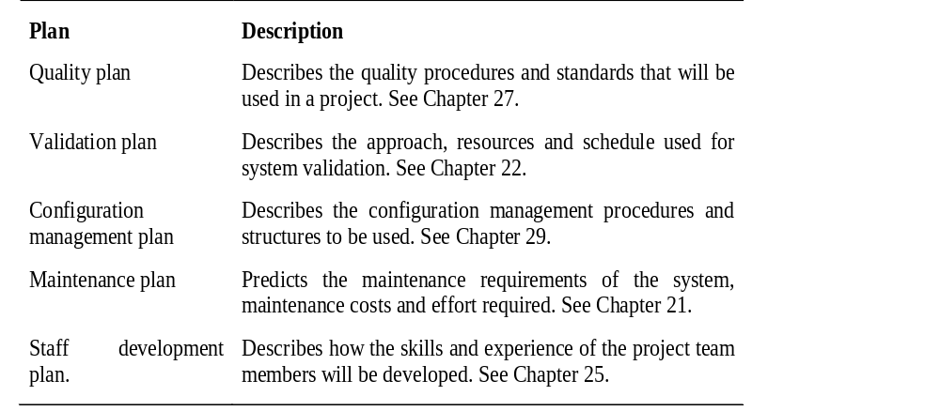
Types of project plan

Slide 12
Project planning process
Establish the project constraints
Make initial assessments of the project parameters
Define project milestones and deliverables
while project has not been completed or cancelled loop
Draw up project schedule
Initiate activities according to schedule
Wait ( for a while )
Review project progress
Revise estimates of project parameters
Update the project schedule
Re-negotiate project constraints and deliverables
if ( problems arise ) then
Initiate technical review and possible revision
end if
end loop

Slide 13
The project plan
The resources available to the project;
The work breakdown;
A schedule for the work.

Slide 14
Project plan structure
Introduction.
Project organisation.
Risk analysis.
Hardware and software resource requirements.
Work breakdown.
Project schedule.
Monitoring and reporting mechanisms.

Slide 15
Project scheduling
Chia dự án thành các nhiệm vụ và dự toán thời gian, nguồn lực cần thiết để hoàn thành mỗi nhiệm vụ.
Tổ chức thực hiện các nhiệm vụ đồng thời để sử dụng tối ưu lực lượng lao động.
Giảm thiểu sự phụ thuộc giữa nhiệm vụ để tránh sự chậm trễ gây ra bởi một nhiệm vụ nào đó để dự án hoàn thành đúng tiến độ.
Phụ thuộc vào trực giác và kinh nghiệm quản lý dự án.

Slide 16
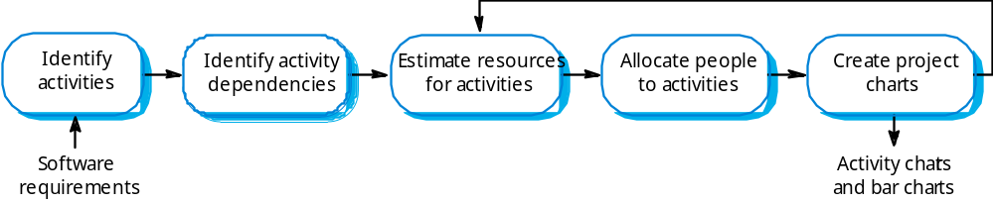
The project scheduling process

Slide 17
Scheduling problems
Đánh giá mức độ khó khăn của vấn đề và chi phí phát triển giải pháp là một bài toán khó.
Năng suất lao động không tỷ lệ thuận với số lượng người làm việc trên một nhiệm vụ.
Thêm người vào dự án chậm làm cho dự án bị kéo dài do phát sinh các chi phí truyền thông.

Slide 18
Bar charts and activity networks
Graphical notations used to illustrate the project schedule.
Show project breakdown into tasks. Tasks should not be too small. They should take about a week or two.
Activity charts show task dependencies and the critical path.
Bar charts show schedule against calendar time.

Slide 19
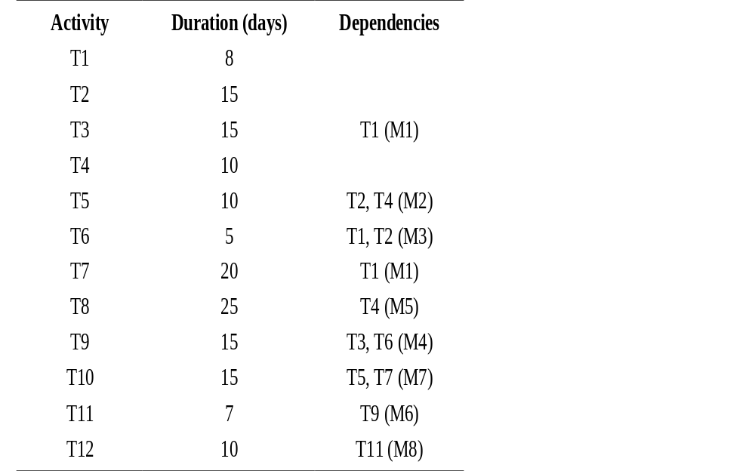
Task durations and dependencies

Slide 20
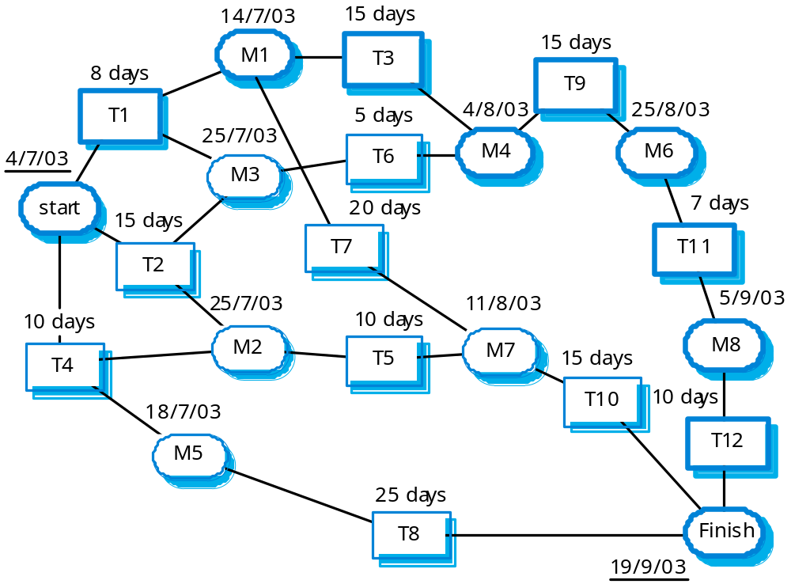
Activity network

Slide 21
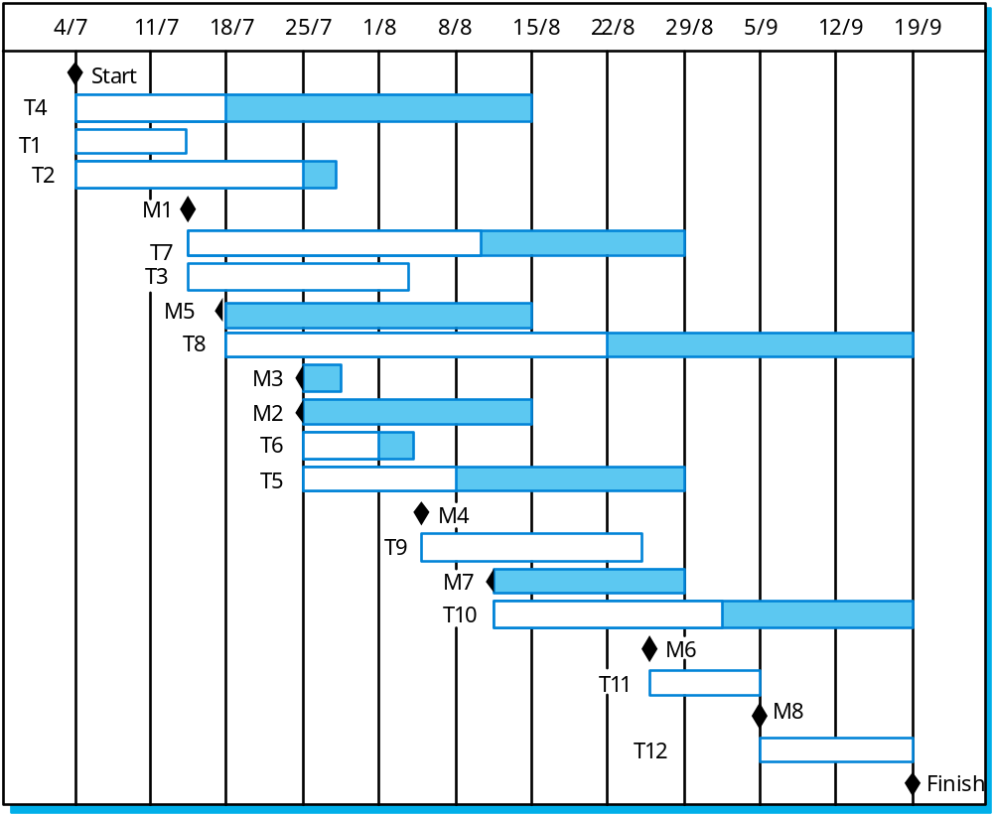
Activity timeline

Slide 22
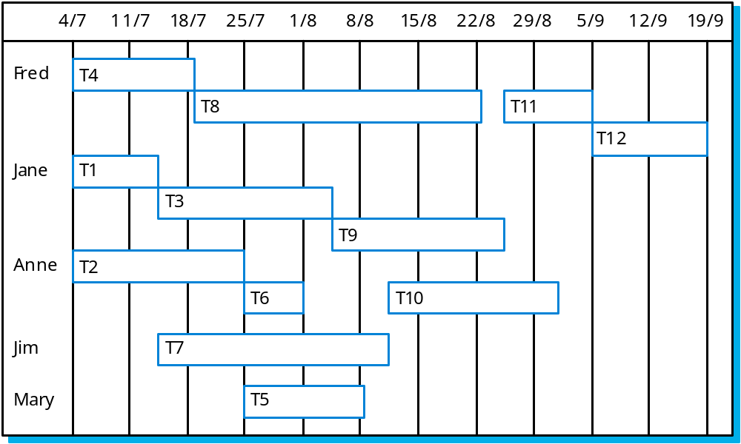
Staff allocation

Slide 23
Risk management
Risk management is concerned with identifying risks and drawing up plans to minimise their effect on a project.
A risk is a probability that some adverse circumstance will occur
  Project risks affect schedule or resources;
  Product risks affect the quality or performance of the software being developed;
  Business risks affect the organisation developing or procuring the software.

Slide 24
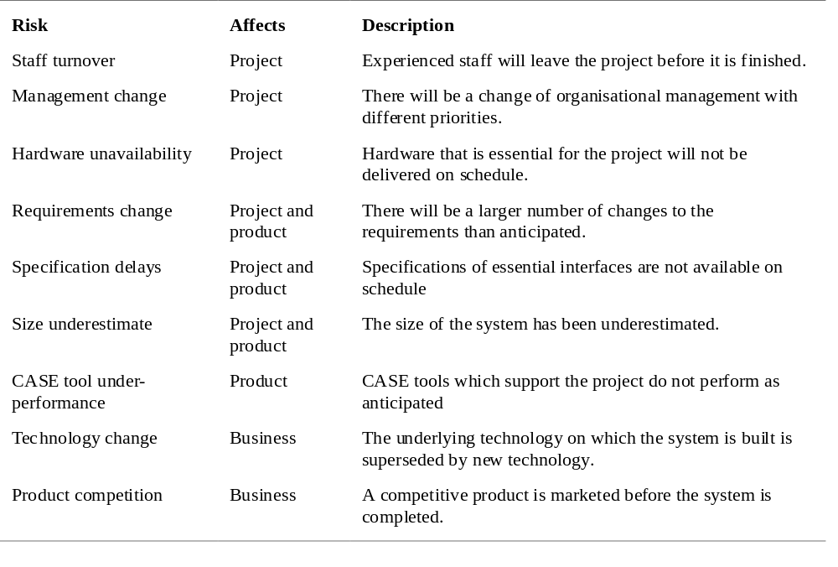
Software risks

Slide 25
The risk management process
Risk identification
  Identify project, product and business risks;
Risk analysis
  Assess the likelihood and consequences of these risks;
Risk planning
  Draw up plans to avoid or minimise the effects of the risk;
Risk monitoring
  Monitor the risks throughout the project;

Slide 26
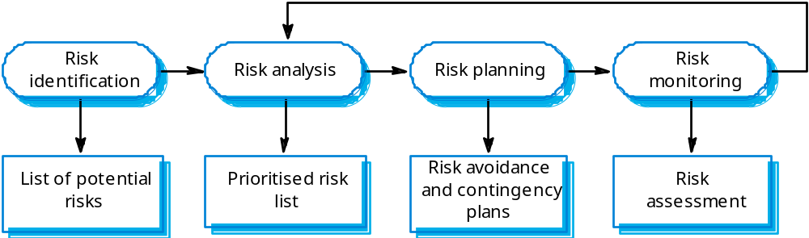
The risk management process

Slide 27
Working environments
The physical workplace provision has an important
effect on individual productivity and satisfaction
  Comfort;
  Privacy;
  Facilities.
Health and safety considerations must be taken
into account
  Lighting;
  Heating;
  Furniture.

Slide 28
The People Capability Maturity Model
Intended as a framework for managing the development of people involved in software development.

Slide 29
P-CMM Objectives
To improve organisational capability by improving workforce capability.
To ensure that software development capability is not reliant on a small number of individuals.
To align the motivation of individuals with that of the organisation.
To help retain people with critical knowledge and skills.

Slide 30
P-CMM levels
Five stage model
  Initial. Ad-hoc people management
  Repeatable. Policies developed for capability improvement
  Defined. Standardised people management across the organisation
  Managed. Quantitative goals for people management in place
  Optimizing. Continuous focus on improving individual competence and workforce motivation

Slide 31
Software cost estimation

Slide 32
Fundamental estimation questions
How much effort is required to complete an activity?
How much calendar time is needed to complete an activity?
What is the total cost of an activity?
Project estimation and scheduling are interleaved management activities.

Slide 33
Software cost components
Hardware and software costs.
Travel and training costs.
Effort costs (the dominant factor in most
projects)
  The salaries of engineers involved in the project;
  Social and insurance costs.
Effort costs must take overheads into account
  Costs of building, heating, lighting.
  Costs of networking and communications.
  Costs of shared facilities (e.g library, staff restaurant, etc.).

Slide 34
Costing and pricing
Estimates are made to discover the cost, to the developer, of producing a software system.
There is not a simple relationship between the development cost and the price charged to the customer.
Broader organisational, economic, political and business considerations influence the price charged.

Slide 35
Productivity measures
Size related measures based on some output from the software process. This may be lines of delivered source code, object code instructions, etc.
Function-related measures based on an estimate of the functionality of the delivered software. Function-points are the best known of this type of measure.

Slide 36
Lines of code
What's a line of code?
  The measure was first proposed when programs were typed on cards with one line per card;
  How does this correspond to statements as in Java which can span several lines or where there can be several statements on one line.
What programs should be counted as part of the system?
This model assumes that there is a linear relationship between system size and volume of documentation.

Slide 37
Function points
Based on a combination of program characteristics
  external inputs and outputs;
  user interactions;
  external interfaces;
  files used by the system.
A weight is associated with each of these and the function point count is computed by multiplying each raw count by the weight and summing all values.
UFC = Σ(number of elements of given type) *(weight)

Slide 38
Function points
The function point count is modified by complexity of the project
FPs can be used to estimate LOC depending on the average number of LOC per FP for a given language
  LOC = AVC * number of function points;
  AVC is a language-dependent factor varying from 200-300 for assemble language to 2-40 for a 4GL;
FPs are very subjective. They depend on the estimator
  Automatic function-point counting is impossible.

Slide 39
Object points
Object points (alternatively named application points) are an alternative function-related measure to function points when 4Gls or similar languages are used for development.
Object points are NOT the same as object classes.
The number of object points in a program is a weighted estimate of
  The number of separate screens that are displayed;
  The number of reports that are produced by the system;
  The number of program modules that must be developed to supplement the database code;

Slide 40
Object point estimation
Object points are easier to estimate from a specification than function points as they are simply concerned with screens, reports and programming language modules.
They can therefore be estimated at a fairly early point in the development process.
At this stage, it is very difficult to estimate the number of lines of code in a system.

Slide 41
Productivity estimates
Real-time embedded systems, 40-160
LOC/P-month.
Systems programs , 150-400 LOC/P-month.
Commercial applications, 200-900
LOC/P-month.
In object points, productivity has been measured between 4 and 50 object points/month depending on tool support and developer capability.

Slide 42
Quality and productivity
All metrics based on volume/unit time are
flawed because they do not take quality into
account.
Productivity may generally be increased at the
cost of quality.
It is not clear how productivity/quality metrics
are related.
If requirements are constantly changing then an approach based on counting lines of code is not meaningful as the program itself is not static;

Slide 43
Estimation techniques
There is no simple way to make an accurate estimate of the effort required to develop a software system
  Initial estimates are based on inadequate information in a user requirements definition;
  The software may run on unfamiliar computers or use new technology;
  The people in the project may be unknown.
Project cost estimates may be self-fulfilling
  The estimate defines the budget and the product is adjusted to meet the budget.

Slide 44
The COCOMO model
An empirical model based on project experience.
Well-documented, ‘independent’ model which is not tied to a specific software vendor.
Long history from initial version published in 1981 (COCOMO-81) through various instantiations to COCOMO 2.
COCOMO 2 takes into account different approaches to software development, reuse, etc.

Slide 45
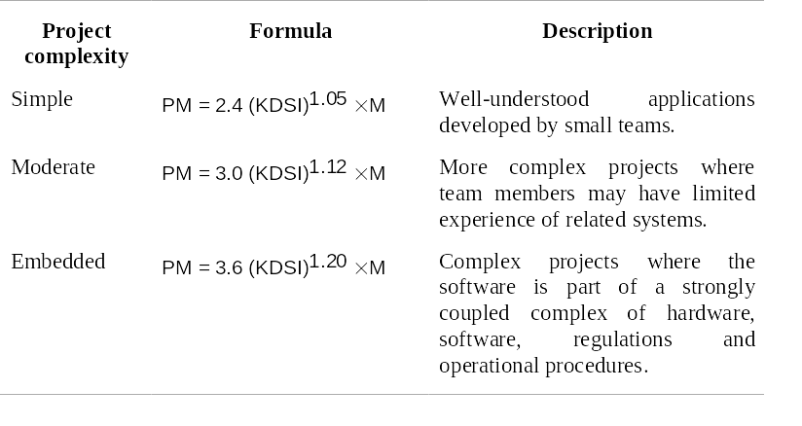
COCOMO 81

Slide 46
Process Improvement

Slide 47
Process improvement
Hiểu biết về các quy trình hiện có và giới thiệu quá trình thay đổi để cải thiện chất lượng sản phẩm, giảm chi phí hoặc đẩy nhanh tiến độ.
Hầu hết các công việc cải tiến quy trình cho đến nay tập trung vào việc giảm khiếm khuyết. Điều này phản ánh sự quan tâm ngày càng tăng của ngành công nghiệp đối với chất lượng.
Tuy nhiên, các thuộc tính khác của quá trình sản xuất phát triển cũng cần được cải tiến.

Slide 48
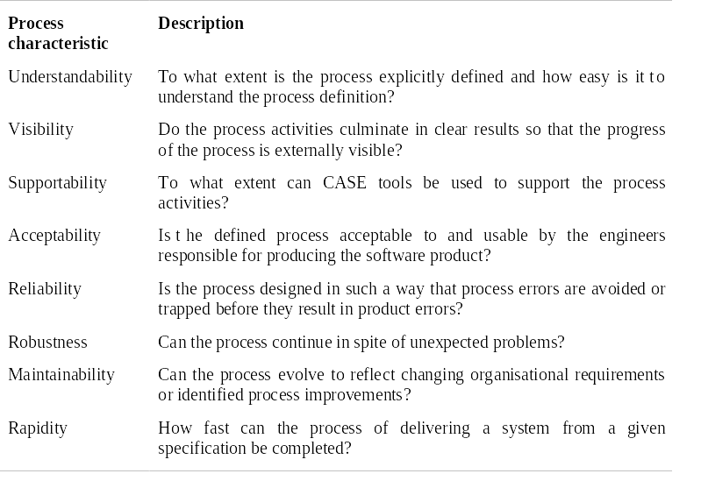
Process attributes

Slide 49
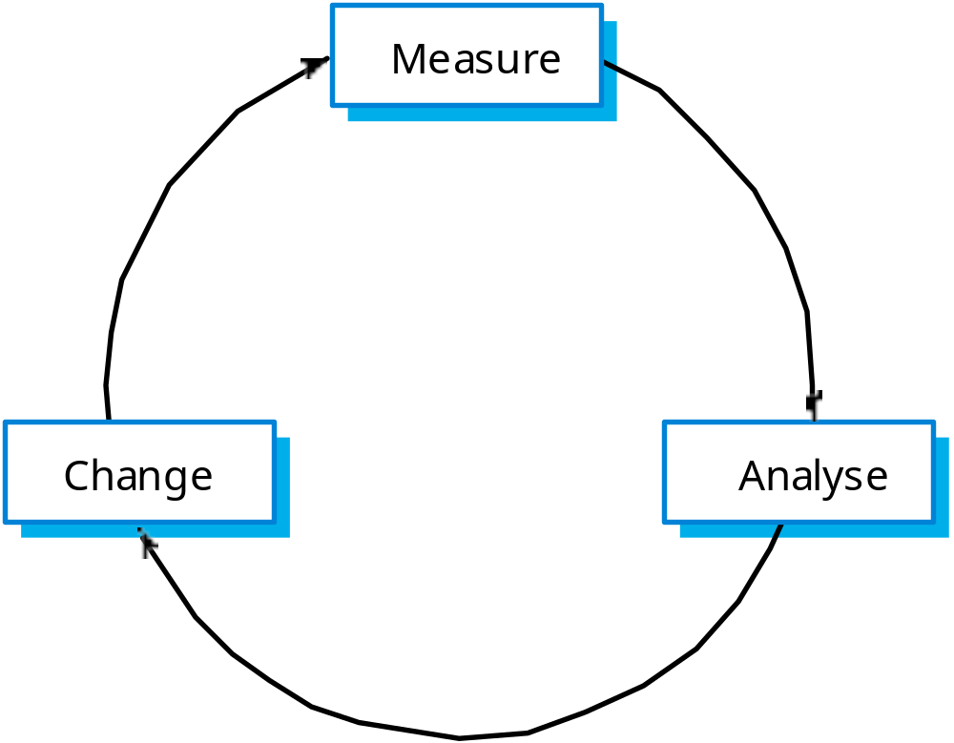
The process improvement cycle

Slide 50
Process improvement stages
Process measurement
  Attributes of the current process are measured. These are a baseline for assessing improvements.
Process analysis
  The current process is assessed and bottlenecks and weaknesses are identified.
Process change
  Changes to the process that have been identified during the analysis are introduced.

Slide 51
Process and product quality
Process quality and product quality are closely
related and process improvement benefits arise because the quality of the product depends on its development process.
A good process is usually required to produce a
good product.
For manufactured goods, process is the
principal quality determinant.
For design-based activity, other factors are also involved especially the capabilities of the designers.

Slide 52
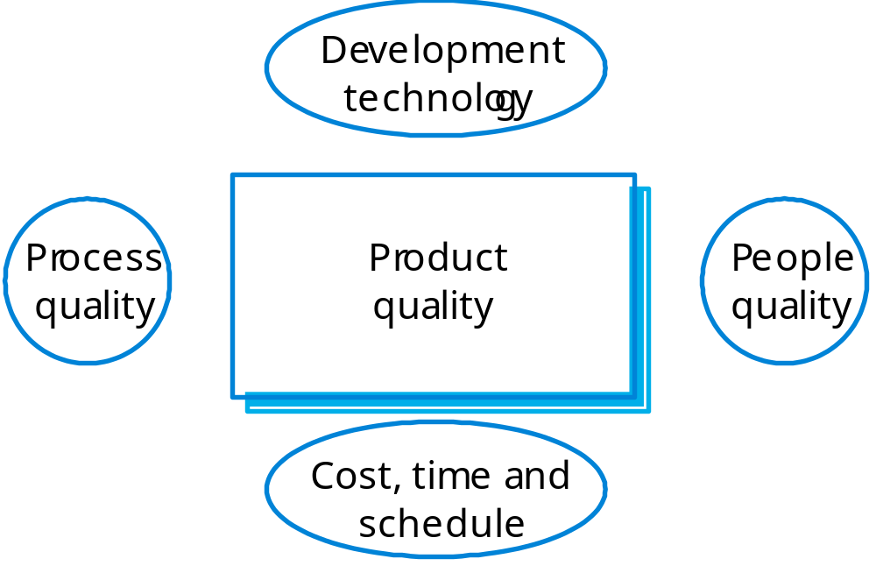
Principal product quality factors

Slide 53
Quality factors
For large projects with ‘average’ capabilities, the development process determines product quality.
For small projects, the capabilities of the developers is the main determinant.
The development technology is particularly significant for small projects.
In all cases, if an unrealistic schedule is imposed then product quality will suffer.

Slide 54
Process measurement
Wherever possible, quantitative process data
should be collected
  However, where organisations do not have clearly defined process standards this is very difficult as you don’t know what to measure. A process may have to be defined before any measurement is possible.
Process measurements should be used to
assess process improvements
  But this does not mean that measurements should drive the improvements. The improvement driver should be the organizational objectives.

Slide 55
Classes of process measurement
Time taken for process activities to be
completed
  E.g. Calendar time or effort to complete an activity or process.
Resources required for processes or activities
  E.g. Total effort in person-days.
Number of occurrences of a particular event
  E.g. Number of defects discovered.

Slide 56
Goal-Question-Metric Paradigm
Goals
  What is the organisation trying to achieve? The objective of process improvement is to satisfy these goals.
Questions
  Questions about areas of uncertainty related to the goals. You need process knowledge to derive these.
Metrics
  Measurements to be collected to answer the questions.

Slide 57
Process analysis and modelling
Process analysis
  The study of existing processes to understand the relationships between parts of the process and to compare them with other processes.
Process modelling
  The documentation of a process which records the tasks, the roles and the entities used;
  Process models may be presented from different perspectives.

Slide 58
Process analysis and modelling
Study an existing process to understand its
activities.
Produce an abstract model of the process.
  You should normally represent this graphically. Several different views (e.g. activities, deliverables, etc.) may be required.
Analyse the model to discover process
problems.
  This involves discussing process activities with stakeholders and discovering problems and possible process changes.

Slide 59
The CMMI framework
The CMMI framework is the current stage of work on process assessment and improvement that started at the Software Engineering Institute in the 1980s.
The SEI’s mission is to promote software technology transfer particularly to US defence contractors.
It has had a profound influence on process improvement
  Capability Maturity Model introduced in the early 1990s.
  Revised maturity framework (CMMI) introduced in 2001.

Slide 60
Process capability assessment
Intended as a means to assess the extent to which an organisation’s processes follow best practice.
There have been various process assessment and improvement models but the SEI work has been most influential.

Slide 61
The SEI capability maturity model
Initial
  Essentially uncontrolled
Repeatable
  Product management procedures defined and used
Defined
  Process management procedures and strategies defined
  and used
Managed
  Quality management strategies defined and used
Optimising
  Process improvement strategies defined and used

Slide 62
Problems with the CMM
Practices associated with model levels
  Companies could be using practices from different levels at the same time but if all practices from a lower level were not used, it was not possible to move beyond that level
Discrete rather than continuous
  Did not recognise distinctions between the top and the bottom of levels
Practice-oriented
  Concerned with how things were done (the practices) rather than the goals to be achieved.

Slide 63
The CMMI model
An integrated capability model that includes software and systems engineering capability assessment.
The model has two instantiations
  Staged where the model is expressed in terms of capability levels;
  Continuous where a capability rating is computed.

Slide 64
CMMI model components
Process areas
  24 process areas that are relevant to process capability and improvement are identified. These are organised into 4 groups.
Goals
  Goals are descriptions of desirable organisational states. Each process area has associated goals.
Practices
  Practices are ways of achieving a goal - however, they are advisory and other approaches to achieve the goal may be used.

Slide 65
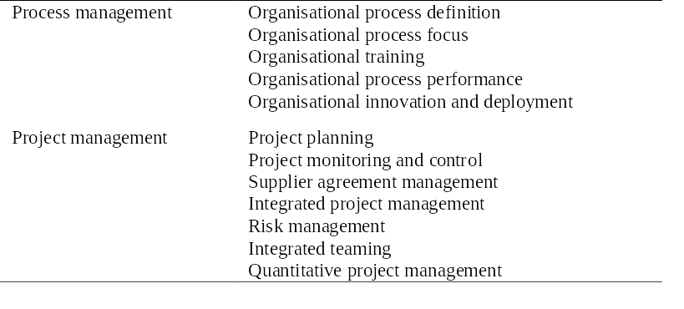
CMMI process areas 1

Slide 66
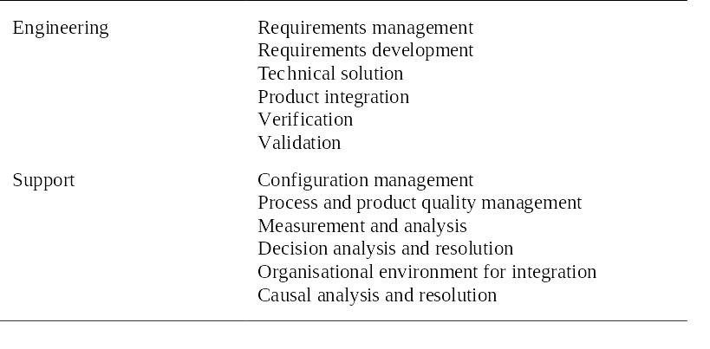
CMMI process areas 2

Slide 67
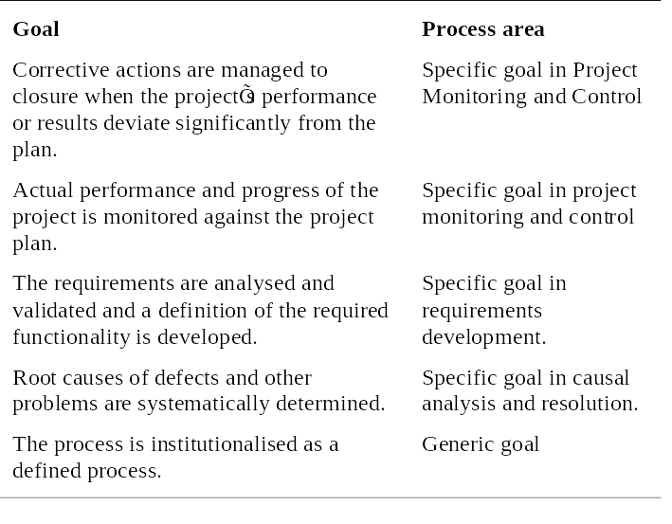
CMMI goals

Slide 68
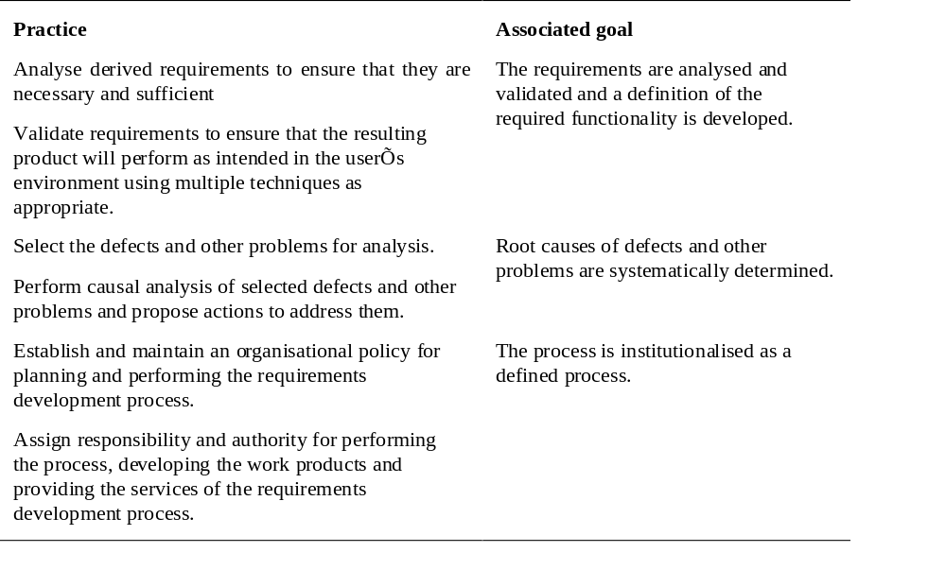
CMMI practices

Slide 69
CMMI assessment
Examines the processes used in an organisation and assesses their maturity in each process area.
Based on a 6-point scale:
  Not performed;
  Performed;
  Managed;
  Defined;
  Quantitatively managed;
  Optimizing.

Slide 70
The staged CMMI model
Comparable with the software CMM.
Each maturity level has process areas and goals. For example, the process area associated with the managed level include:
  Requirements management;
  Project planning;
  Project monitoring and control;
  Supplier agreement management;
  Measurement and analysis;
  Process and product quality assurance.

Slide 71
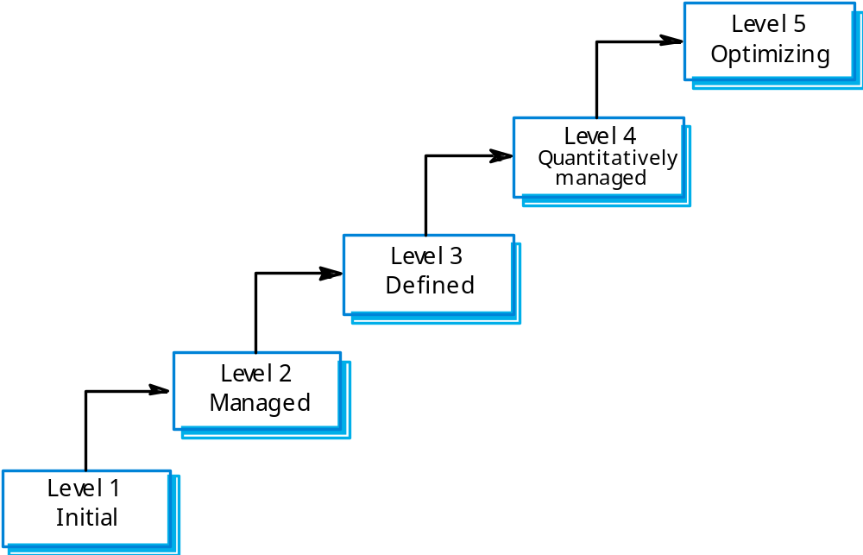
The staged CMMI model

Slide 72
Institutional practices
Institutions operating at the managed level should have institutionalised practices that are geared to standardisation.
  Establish and maintain policy for performing the project management process;
  Provide adequate resources for performing the project management process;
  Monitor and control the project planning process;
  Review the activities, status and results of the project planning process.

Slide 73
The continuous CMMI model
This is a finer-grain model that considers individual or groups of practices and assesses their use.
The maturity assessment is not a single value but is a set of values showing the organisations maturity in each area.
The CMMI rates each process area from levels 1 to 5.
The advantage of a continuous approach is that organisations can pick and choose process areas to improve according to their local needs.

Slide 74
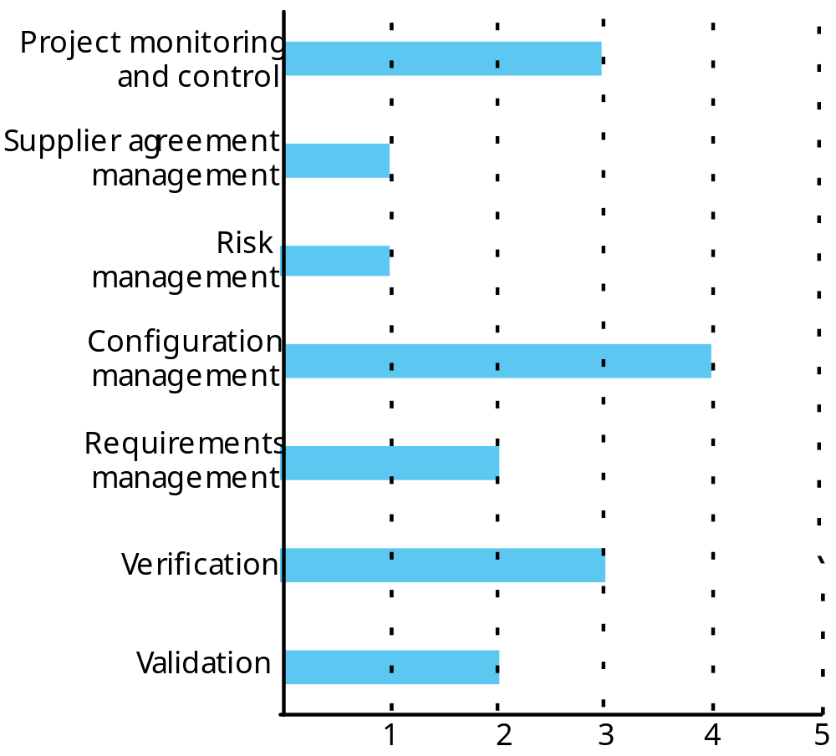
A process capability profile

Slide 75
Tài liệu tham khảo
R. Pressman, Kỹ nghệ phần mềm. Tập 1, 2, 3. NXB Giáo dục, Hà Nội, 1997 (Người dịch: Ngô Trung Việt).
R. Pressman, Software Engineering: A Practioner’s Approach. 5th Ed., McGraw-Hill, 2001. Chapters 3, 4, 5, 6, 7.
I. Sommerville, Software Engineering. 5th Ed., Addison-Wesley, 1995. Chapters 22, 23, 25.

